Slide 1
Diabetic Retinopathy Detection
Post-Graduate Major Project
SID: 2022785

Slide 2
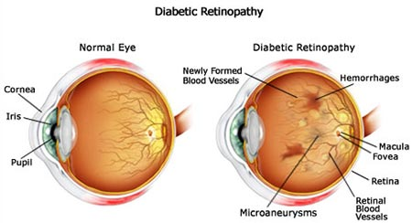
Introduction
Diabetic Retinopathy is a serious eye disease that occurs in the retina of the eye.
Mostly occurs in patients who are suffering from diabetes from more than 20 years.
DR leads to blindness if not detected at an early stages.
DR is classified into four stages
Mild NPDR
Moderate NPDR
Severe NPDR
Proliferative Diabetic Retinopathy (PDR)
In Mild and Moderate stages, Microaneurysms and Haemorrhages, Hard Exudates, Cotton Wool Spots are formed respectively.
In Severe and Proliferative stages, along with above-mentioned lesions, other lesions such as abnormal and new blood vessels, and pre-retinal haemorrhages are formed respectively.
To avoid blindness, eye treatments and injections are helpful at an early stages. But these are costly in under-developed regions.
To overcome costly diagnosis and treatments, Machine Learning models in Artificial Intelligence are implemented to detect DR at an Early stages.

Slide 3
Motivation
Out of all patients suffering with diabetes from more than 20 years, 80% of them are suffering from Diabetic Retinopathy.
By the year 2030, the number of patients with diabetic retinopathy will reach to 191 millions and vision-threatening diabetic retinopathy will rise to 56.3 millions globally.
To reduce the count, patients need to undergo early diagnosis. But, these diagnosis involves manual detection of lesions by Ophthalmologist. So, this is a time- and cost-consuming process.
Moreover, in under-developed regions, patients are suffering from lack of eye hospitals.
To overcome all issues, Machine Learning Scientist developed an easy and effective approach to detect the Diabetic Retinopathy in the patient’s eye at an early stages.

Slide 4
Literature Summary
STUDY | DATASET & Image pre-processing | CNN & RESULTS | CONS
Xu, Feng, and Mi (2017) (binary classification) | Kaggle – 1000 Data Aug – Flip, Rescale, Rotation, transition | CNN – 8 Conv, 4 MP, 2 FC Act Fn – SoftMax. Acc - 94.5% | Limited number of retinal fundus images and not detected 5 DR stages
Pratt et al. (2016) (multi-level classification) | Kaggle dataset – 80,000 Steps – color normalization & 512 x 512 pixels | CNN – 10 Conv, 8 MP, 3 FC Act Fn - SoftMax Acc – 75%, Spec – 95%, Sens – 30% | Not able to detect all stages of DR
Yan, Gong, and Liu (2019) (lesion-based classification) | DIARETDB1 – 89 Steps – green channel-ROI by threshold segment-CLAHE-gaussian-morphological | LeNet CNN – 4 Conv, 3 MP, 1 FC Act Fn – Random Forest Classifier Sensitivity – 48.71% | Achieved low accuracy on detecting lesions and not classified images into 5 stages.
Budak et al. (2020) (vessel-based classification) | DRIVE – 40 & STARE – 20 Steps – patch-based data aug – flipping & rotation | DRIVE – acc – 0.9685, AUC – 0.9822 & STARE – acc – 0.9735, AUC – 0.9868 DCCMED – 8 Conv, 8 BN, 2 MP & un-MP | Extracted blood vessels. But not detected MAs, HAs, and Exudates.
Notes:
In the study performed by the Xu and his team, Kaggle dataset with 1000 DR images and CNN with 8 Convolutional Layers, 4 Max-Pooling Layers, and 2 Fully-Connected Layers with SoftMax activation function are implemented. Before training the CNN architecture, data augmentation techniques such as Flip, Rescale, Rotation, and transition are implemented. The proposed approach achieved an accuracy of 94.5%. Due to less data used to train the CNN, the proposed architecture is not able to detect all 5 DR stages.
The approach implemented by Pratt and his team achieved an accuracy of 75%, Specificity (Correctly identifying normal images) of 95%, Sensitivity (Correctly classifying DR images) of 30%. In this approach, Kaggle dataset with 80,000 images and CNN with 10 Convolutional Layers, 8 Max-pooling Layers, and 3 Fully-Connected Layers with SoftMax activation function. Before training the CNN architecture, Color Normalization technique is applied and then images are resized to 512x512 pixels. The proposed method not able identify the DR images accurately.
The Other two studies performed by Yan and Budak can able to extract DR lesions and blood vessels respectively. These two studies are not able classify images into 5 DR stages.

Slide 5
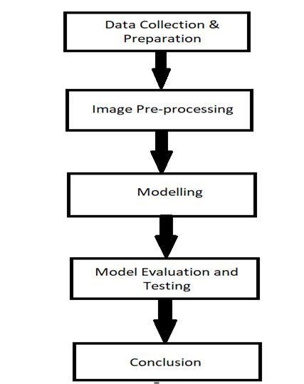
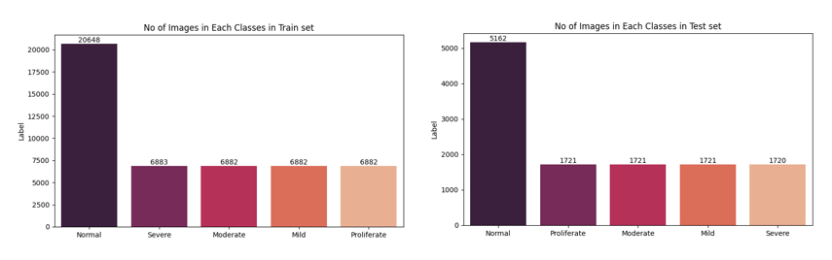
Methodology
The proposed methodology involves data collection & preparation, image pre-processing and training a pre-trained model known as ‘Inception-V3’.
In data collection & preparation step, a well-known public dataset known as ‘Kaggle’ is used. The dataset used in this approach is the resized version of original diabetic retinopathy dataset known as ‘Diabetic Retinopathy Detection’. This dataset contains a total of 35,126 retinal images. Out of these images, 25,810 images are considered as Normal.
To maintain balanced dataset, oversampling technique is implemented.
Notes:
The dataset contains a total of 35,126 DR images. In which, around 26,000 images are considered as the normal images whereas the around 800 is considered as the proliferative DR. From the count, it is clear that the dataset is hugely imbalanced.
In the data collection & preparation step, to maintain balanced dataset and to reduce over-fitting, oversampling technique is implemented by increasing minority classes to the one-third of the majority classes.

Slide 6
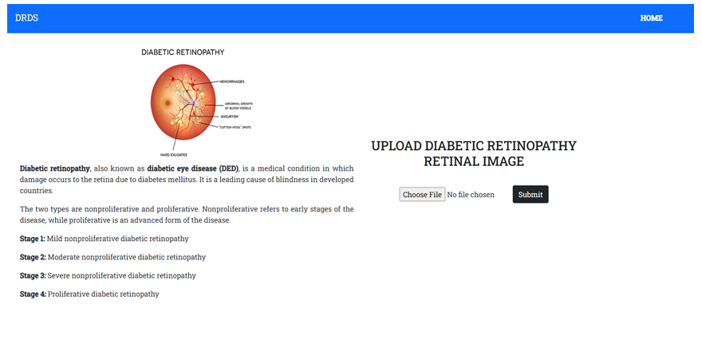
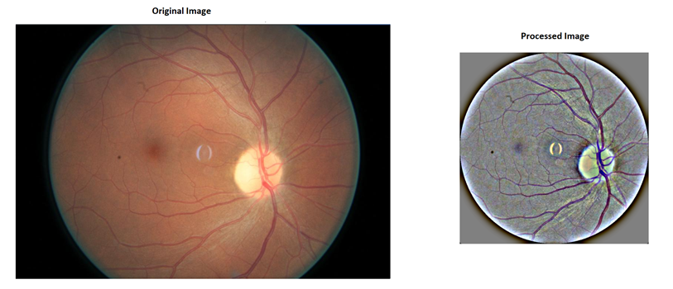
Methodology
In image pre-processing step, before applying Ben Graham processing method, the images are masked and cropped to maintain constant retinal structure and FOV across all images.
The modified Inception-V3 architecture consists of 2 dense layers with 1024 nodes with ReLU activation function and 1 Dropout Layer and 1 last fully-connected layer with softmax as the activation function.
Later, the trained version of the Inception-V3 is fine-tuned by freezing only top two layers.
The saved model is later used in web application to detect DR in user upload DR images.
Notes:
In the Image pre-processing step, first the images are converted to Gray-scale image. Later, the Gray-scale images are cropped by removing the unnecessary black background in the images.
Once the images are cropped, the well-known image processing method known as ‘Ben Graham’ method is applied on the cropped images. The ben graham method enhancing the features in the image.
To classify the images into 5 DR stages, the well-known pre-trained model known as ‘Inception-V3’ is used. The Inception-V3 architecture is modified by adding 2 fully connected layers with 1024 neurons with ReLU activation function, 1 Dropout layer of 0.5 value, 1 logistic layer with SoftMax activation function.
Later, to improve the accuracy of the trained Inception-V3 model, the first two layers are frozen and trained the entire network. Once the model is fine-tuned and saved, the saved model is then later used to classify the user uploaded image into 5 DR stages.

Slide 7
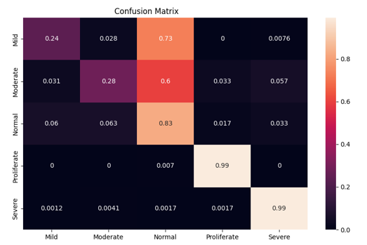
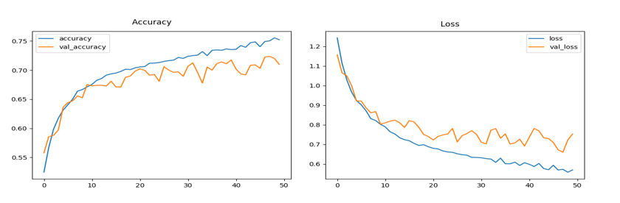
Results
In the initial training with 20 epochs, the inception_v3 achieved an accuracy of 71.23% with test loss of 0.75042, with precision, Recall, and F1 score of 0.36501, 0.40413, and 0.36548 respectively.
The initial trained Inception-V3 model obtained an accuracy of 39.47% with a test loss of 4.74626 and with precision, recall, and F1 score of 0.36501, 0.40413, and 0.36548 respectively.

Slide 8
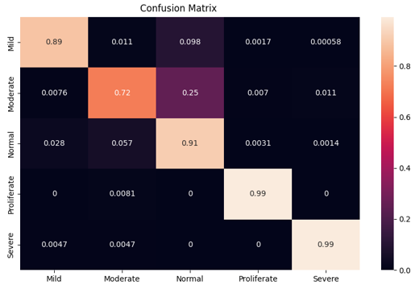
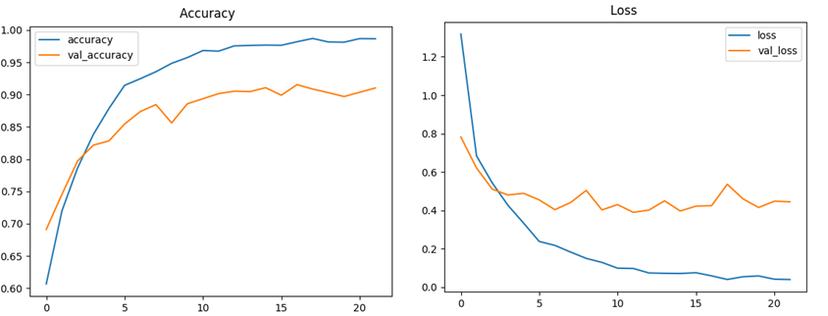
Results
Later, the trained model is fine-tuned and trained with 50 epochs and obtained an accuracy of 90.39% with test loss of 0.40295, with precision, recall, and F1 score of 0.9025, 0.90386, and 0.9029 respectively.
The fine-tuned version of inception-v3 achieved an accuracy of 54.22% with test loss of 4.17766 and obtained precision, recall, and F1 score of 0.4686, 0.53641, and 0.44126 respectively on different dataset known as ‘APTOS 2019 Blindness Detection’.

Slide 9
Discussion
The initial trained inception-v3 model can able to detect last stages of diabetic retinopathy, i.e., Severe and Proliferative DR.
The fine-tuned inception-v3 model can able to detect all stages of Diabetic retinopathy, i.e., Normal, Mild, Moderate, Severe, and Proliferative DR.
Moreover, the Kaggle dataset known as ‘APTOS 2019 Blindness Detection’ is used to evaluate the performance of the fine-tuned model. The dataset is hugely imbalanced. Most of the images are considered as Normal images. This imbalance dataset can impact the accuracy of the model.

Slide 10
Conclusion
The fine-tuned inception-v3 achieved an accuracy of 90%. The accuracy of the model can increase by training on more balanced dataset.
The transfer-learning approach used in this approach saved time- and computational power.
Currently, in the presented work, the extraction of MAs, HAs, and EX is not implemented in the image pre-processing steps. Implementing these extraction techniques can improve the fine-tuned model.

Slide 11
References
Manhattan Eye Doctors & Best Rated Specialists in NYC. (n.d.). Diabetic Retinopathy, Eye Disease Specialist · Top Eye Doctor · NYC. [online] Available at: https://www.eyedoctorophthalmologistnyc.com/treatment/diabetic-retinopathy-eye-disease/.
Xu, K., Feng, D. and Mi, H. (2017). Deep Convolutional Neural Network-Based Early Automated Detection of Diabetic Retinopathy Using Fundus Image. Molecules, 22(12), p.2054. [online] Available at: https://doi.org/10.3390/molecules22122054 [Accessed 29 March 2022].
Pratt, H., Coenen, F., Broadbent, D.M., Harding, S.P. and Zheng, Y. (2016). Convolutional Neural Networks for Diabetic Retinopathy. Procedia Computer Science, 90, pp.200–205 [Accessed 29 March 2022].
Yan, Y., Gong, J. and Liu, Y. (2019). A Novel Deep Learning Method for Red Lesions Detection Using Hybrid Feature. [online] IEEE Xplore. Available at: https://ieeexplore.ieee.org/document/8833190 [Accessed 02 April 2022].
Budak, Ü., Cömert, Z., Çıbuk, M. and Şengür, A. (2020). DCCMED-Net: Densely connected and concatenated multi-Encoder-Decoder CNNs for retinal vessel extraction from fundus images. Medical Hypotheses, 134, p.109426 [Accessed 03 April 2022].

